Slide 1
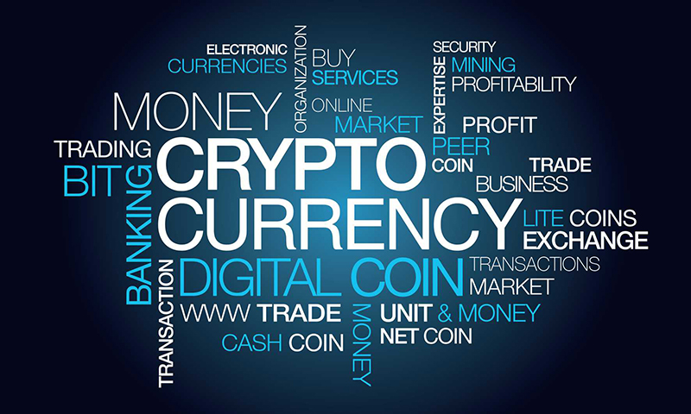
Vidit Virmani
Shruti Reddy
Saksham Ranai

Slide 2
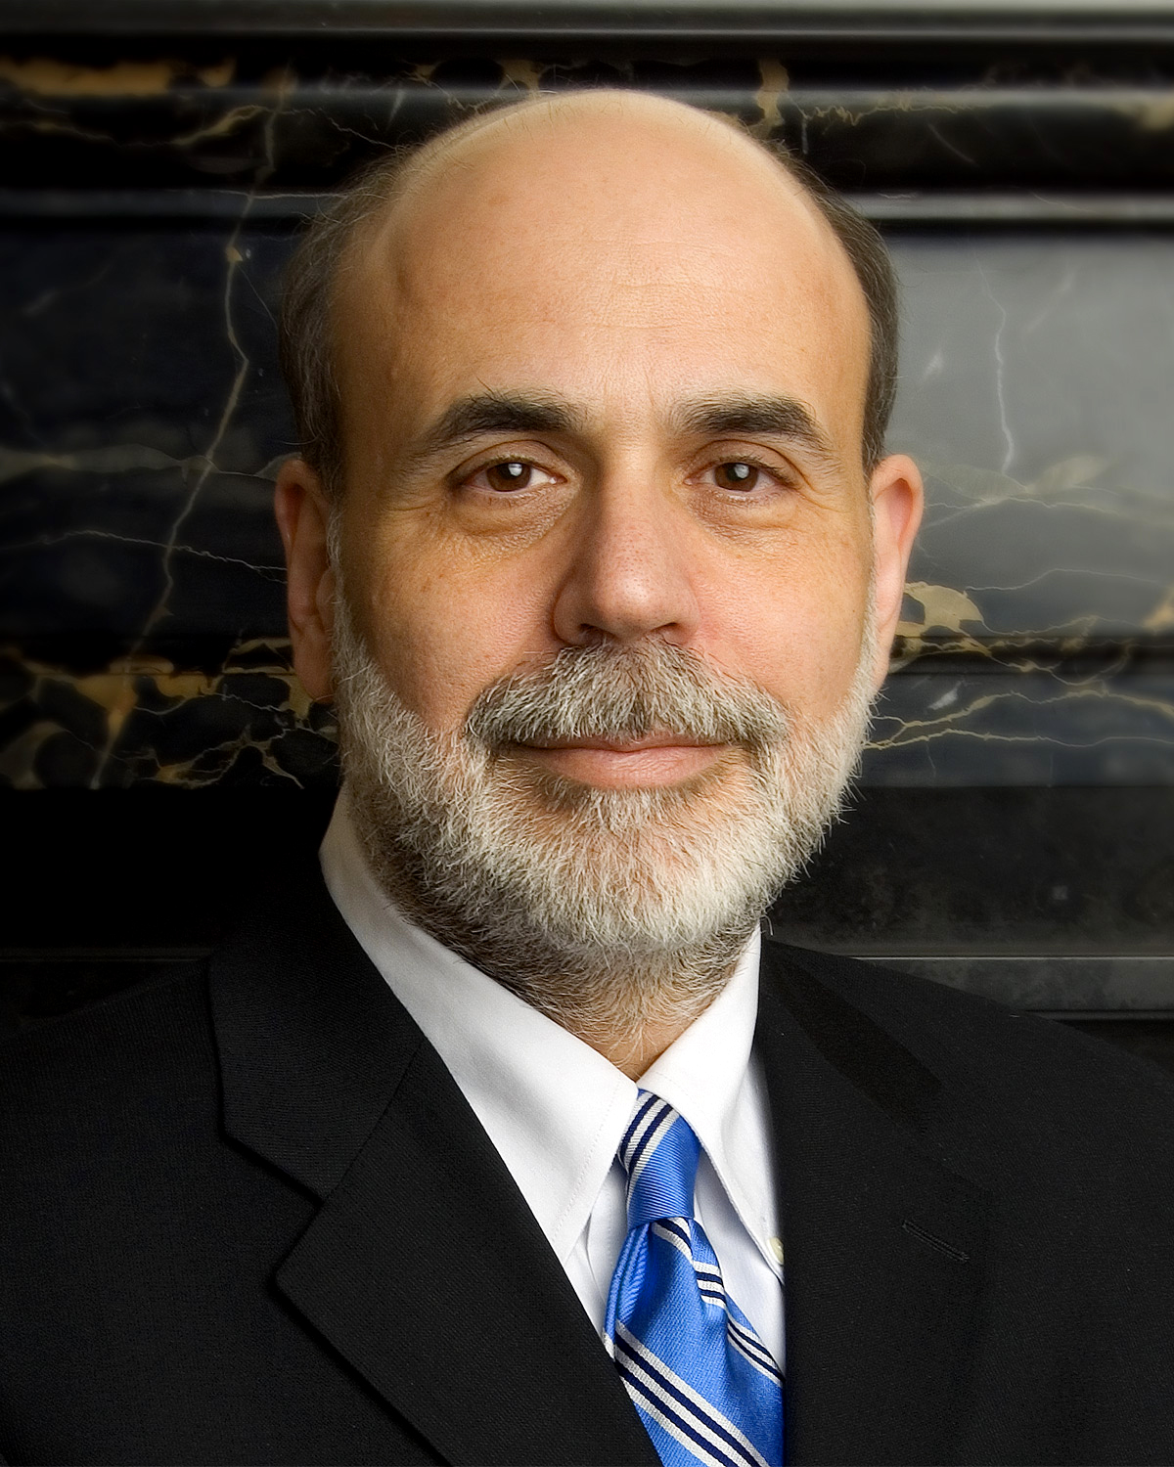
Ben Bernanke
“"[Virtual Currencies] may hold long-term promise, particularly if the innovations promote a faster, more secure and more efficient payment system.” " - Ben Bernanke, Chairman of the Federal Reserve

Slide 3


What is Cryptocurrency?
A cryptocurrency (or crypto currency) is a digital asset designed to work as a medium of exchange using cryptography to secure the transactions, to control the creation of additional units, and to verify the transfer of assets. Cryptocurrencies are classified as a subset of digital currencies and are also classified as a subset of alternative currencies and virtual currencies.

Slide 4
It’s a $200 billion market
Why is it worth noticing?

Slide 5

How it all started?
Bitcoin began trading in 2010, as the first bitcoin exchange opened in March 2010 with a per-coin value of $0.003. The first real-world transaction took place in May 2010, when 10,000 bitcoins were exchanged for two pizzas in Jacksonville, Florida. Since that time, the price of bitcoin has been on quite the roller-coaster ride.

Slide 6
What if I invested in it?
To illustrate just how impressive this rally has been, let's say you had the foresight (or good luck) to purchase $10 worth of bitcoin at the time the first bitcoin exchange opened in March 2010. Based on the $0.003 per-coin price at the time, your $10 would have purchased 3,333 bitcoins.
Current Value:
$21,664,500
“[Bitcoin] is a techno tour de force.” – Bill Gates

Slide 7
What do others have to say about it?
”If we remember 15 years ago if you were doing anything on the internet you were going to make millions. I think it could be the same with Bitcoin”
- Jared Kenna, TradeHill CEO
"Bitcoin will do to banks what email did to the postal industry" - Rick Falkvinge, Founder of the Swedish pirate party
“This may be the purest form of democracy the world has ever known, and I– for one– am thrilled to be here to watch it unfold” – Paco Ahlgren, Financial Analyst at wifi alliance
"You can't stop things like Bitcoin. It will be everywhere and the world will have to readjust. World governments will have to readjust" - John McAfee, Founder of McAfee

Slide 8
Understanding Cryptocurrency
Cryptocurrency in nutshell:
Every cryptocurrency has a public ledger that contains the past and present ownership of each coin.
If you want to make transaction, you simply broadcast to the cryptocurrency’s network that you’re transferring ownership of some cryptocurrency of yours to someone else.
The network then spends computational power on both verifying your transaction (that you do own the cryptocurrency your spending and that you haven’t spent it before), and adding it to the ledger.
In the process, this computational time and effort creates new cryptocurrency as a reward to the community members who helped make the transaction possible

Slide 9
The Problem:
The biggest problem faced by any new investor in cryptocurrency is
WHICH CRYPTOCURRENCY TO INVEST IN?

Slide 10
What we Did?
We developed a R code that would tell you about the best crypto currencies to put your money in by analyzing the real time data of the cryptocurrencies and then predicting their future values.

Slide 11
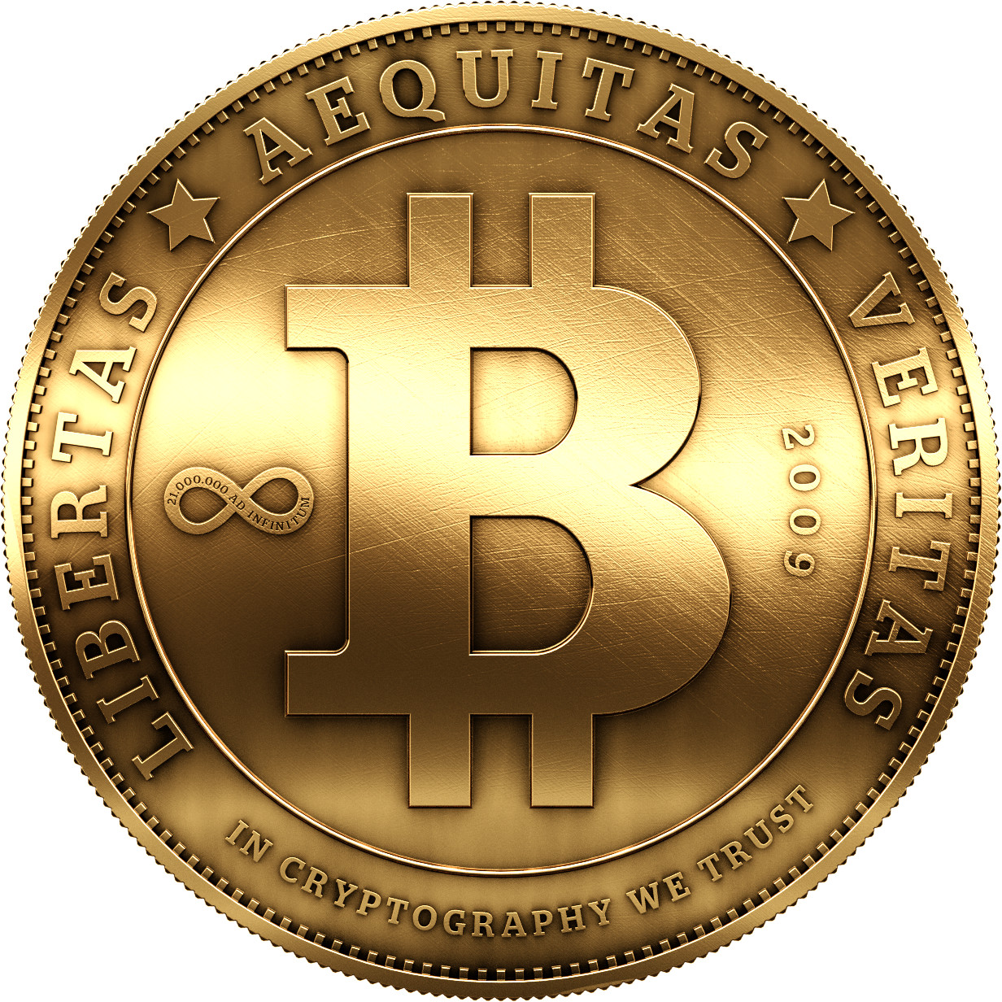



The Understanding
$$$
Data
$$
$

Slide 12
The R code

Slide 13
library(rvest)
library(plotrix)
library(dplyr)
Sys.Date()
endDate=gsub("-","",Sys.Date())
endDate
#Bitcoin Data
url_cmc <- sprintf("https://coinmarketcap.com/currencies/bitcoin/historical-data/?start=20130804&end=%s",endDate)
url_cmc %>%
read_html() %>%
html_nodes(css = "table") %>%
html_table() %>%
as.data.frame() -> "BitcoinData"
head(BitcoinData)
#Litecoin Data
url_cmc <- sprintf("https://coinmarketcap.com/currencies/litecoin/historical-data/?start=20130804&end=%s",endDate)
url_cmc %>%
read_html() %>%
html_nodes(css = "table") %>%
html_table() %>%
as.data.frame() -> "LitecoinData"
head(LitecoinData)
#Ethereum Data
url_cmc <- sprintf("https://coinmarketcap.com/currencies/ripple/historical-data/?start=20130804&end=%s",endDate)
url_cmc %>%
read_html() %>%
html_nodes(css = "table") %>%
html_table() %>%
as.data.frame() -> "EthereumData"
head(EthereumData)
#considering only fisrt 5 columns in the data
BData<- BitcoinData[,1:5]
LData<- LitecoinData[,1:5]
EData<-EthereumData[1:5]
BData$Change<- (BData$Close-BData$Open)/BData$Open
LData$Change<- (LData$Close-LData$Open)/LData$Open
EData$Change<- (EData$Close-EData$Open)/EData$Open
#Combining all the Change values into one new data frame
DailyReturns <- data.frame(BDate=BData$Date, BCoin=BData$Change,
LDate=LData$Date, LCoin=LData$Change, RDate=EData$Date,
RCoin=EData$Close)
#Declaring three new functions to pick the change values
getBCoinReturn = function(PickRow) {
DailyReturns$BCoin[PickRow]
}
getLCoinReturn = function(PickRow) {
DailyReturns$LCoin[PickRow]
}
getRCoinReturn = function(PickRow) {
DailyReturns$RCoin[PickRow]
}

Slide 14
#eAmt1 for BitCoin Data
#eAmt2 for LiteCoin Data
#eAmt3 for Ethereum Data
#Bootstrapping for 1 years data
bAmt = 1000
investment=data.frame(day=0,PercentBitCoin=0, PercentLiteCoin=0,PercentRippleCoin=0, eAmt1 = 0, eAmt2 = 0, eAmt3 = 0,eAmtFinal= 0)
investment=investment[0,]
eAmt = data.frame(bAmt=0, i=0, j=0, k=0, rBCoin=0, rLCoin=0, rECoin=0,eAmt1=0, eAmt2=0, eAmt3=0, eAmtFinal=0)
for(i in seq(0,100,5)){
#rBCoin<-rBCoin*(i/100)
for(j in seq(0,(100-i),5)){
#rLCoin<-rLCoin*(j/100)
#rECoin<- rECoin*(100-j-i)/100
k=100-j-i
eAmt = eAmt[0,]
for(itrn in c(1:100)){
PickRow = sample(1:nrow(DailyReturns),1)
rBCoin = getBCoinReturn(PickRow)
rLCoin = getLCoinReturn(PickRow)
rECoin = getRCoinReturn(PickRow)
eAmt1 = (bAmt*i/100) * (1 + rBCoin)
eAmt2 = (bAmt*j/100) * (1 + rLCoin)
eAmt3 = (bAmt*k/100) * (1 + rECoin)
eAmtFinal= eAmt1+eAmt2+eAmt3
eAmt = rbind(eAmt,data.frame(bAmt=bAmt, i=i, j=j, k=k, rBCoin=rBCoin, rLCoin=rLCoin, rECoin=rECoin,eAmt1=eAmt1, eAmt2=eAmt2, eAmt3=eAmt3, eAmtFinal=eAmtFinal))
}
mean_eAmtFinal = mean(eAmt$eAmtFinal)
mean_eAmt1= mean(eAmt$eAmt1)
mean_eAmt2= mean(eAmt$eAmt2)
mean_eAmt3=mean(eAmt$eAmt3)
investment=rbind(investment,data.frame(day=1, PercentBitCoin=i/100,PercentLiteCoin=j/100,PercentRippleCoin=(100-j-i)/100, eAmt1 = mean_eAmt1, eAmt2 = mean_eAmt2,
eAmt3 = mean_eAmt3, eAmtFinal= mean_eAmtFinal) )
}
}

Slide 15
combination=1
for(d in c(2:30)){
# bAmt should be the eAmt corresponding to each combination from the previous day
for(i in seq(0,100,5)){
for(j in seq(0,(100-i),5)){
bAmt=investment[combination,8]
combination=combination+1
k=100-j-i
eAmt = eAmt[0,]
for(itrn in c(1:100)){
PickRow = sample(1:nrow(DailyReturns),1)
rBCoin = getBCoinReturn(PickRow)
rLCoin = getLCoinReturn(PickRow)
rECoin = getRCoinReturn(PickRow)
eAmt1 = (bAmt*i/100) * (1 + rBCoin)
eAmt2 = (bAmt*j/100) * (1 + rLCoin)
eAmt3 = (bAmt*k/100) * (1 + rECoin)
eAmtFinal= eAmt1+eAmt2+eAmt3
mean_eAmtFinal = mean(eAmt$eAmtFinal)
mean_eAmt1= mean(eAmt$eAmt1)
mean_eAmt2= mean(eAmt$eAmt2)
mean_eAmt3=mean(eAmt$eAmt3)
lastDay=d
investment=rbind(investment,data.frame(day=d,PercentBitCoin=i/100,PercentLiteCoin=j/100,
PercentRippleCoin=(100-j-i)/100, eAmt1 = mean_eAmt1, eAmt2 = mean_eAmt2,
eAmt3 = mean_eAmt3, eAmtFinal= mean_eAmtFinal) )
}
}
}
tail(investment)
last_day_investment=subset(investment,investment$day==lastDay)
which.max(last_day_investment$eAmtFinal)
last_day_investment[which.max(last_day_investment$eAmtFinal),]
write.csv(investment,file="C:/Users/shrut/Desktop/SDM Project/investment_6.csv")
eAmt = rbind(eAmt,data.frame(bAmt=bAmt, i=i, j=j, k=k, rBCoin=rBCoin, rLCoin=rLCoin, rECoin=rECoin,eAmt1=eAmt1, eAmt2=eAmt2, eAmt3=eAmt3,eAmtFinal=eAmtFinal))}

Slide 16
Report & Graphs

Slide 17
Scenario-1:
Model for 10 days

Slide 18
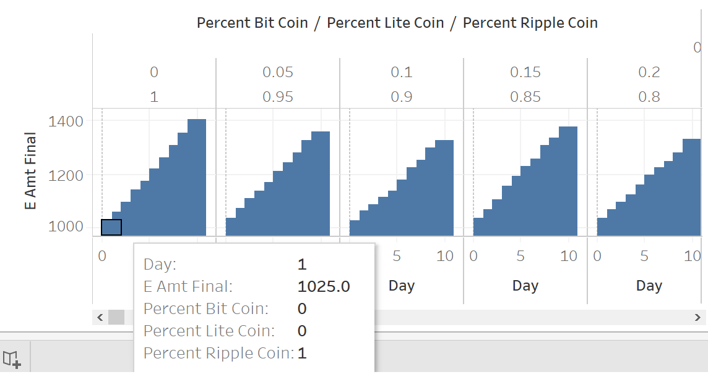

Slide 19
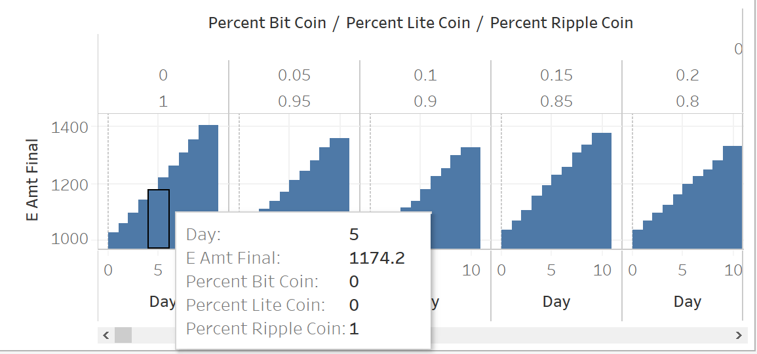

Slide 20
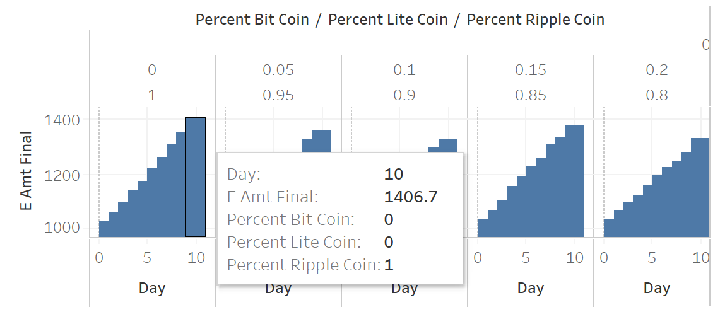

Slide 21
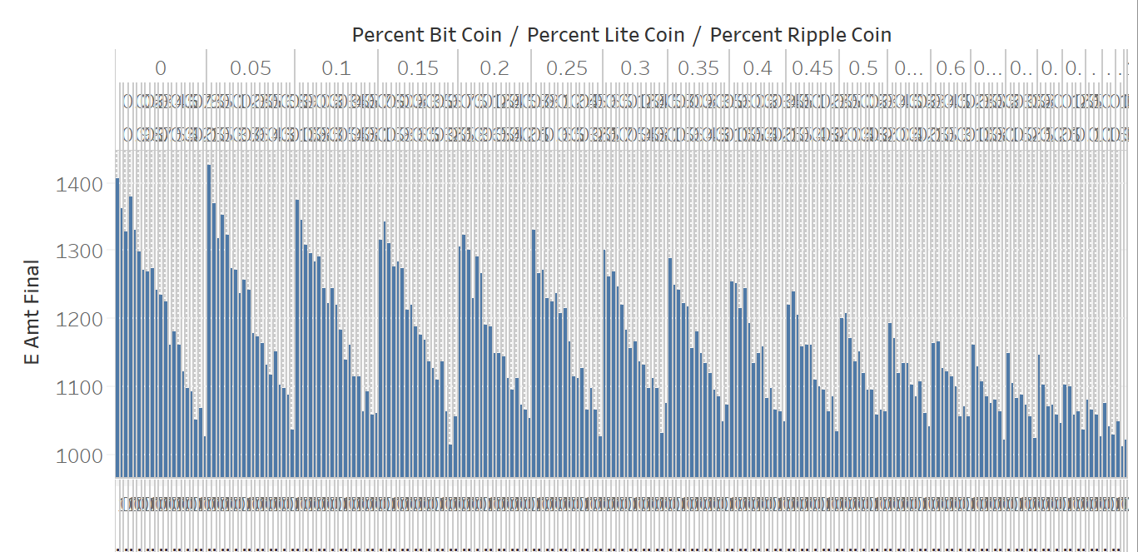

Slide 22
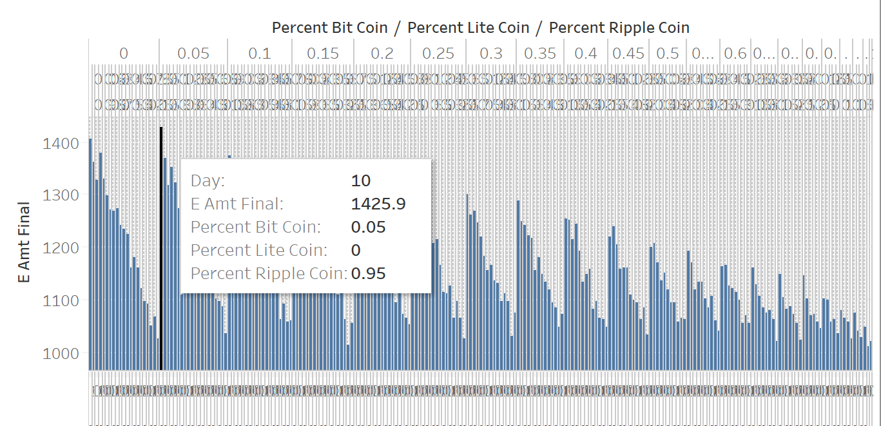

Slide 23


Slide 24
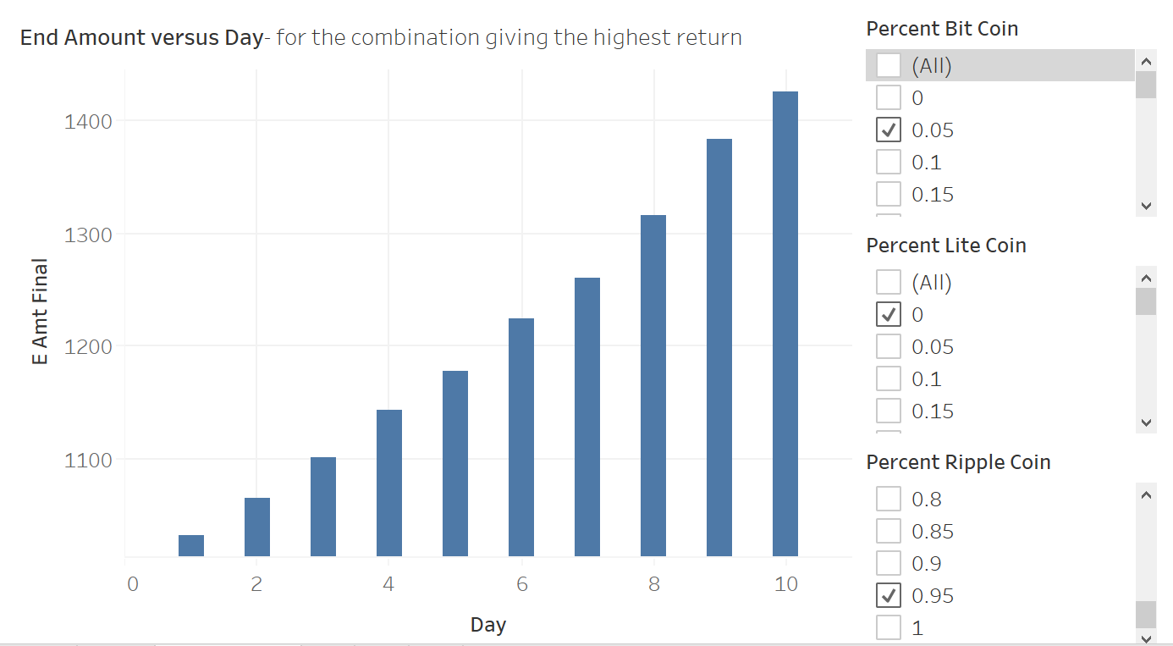

Slide 25
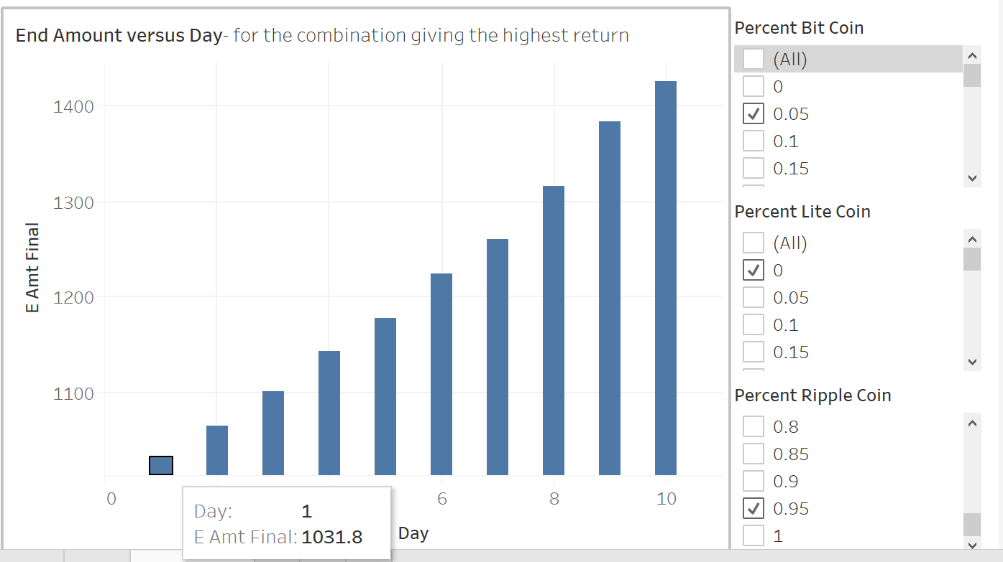

Slide 26
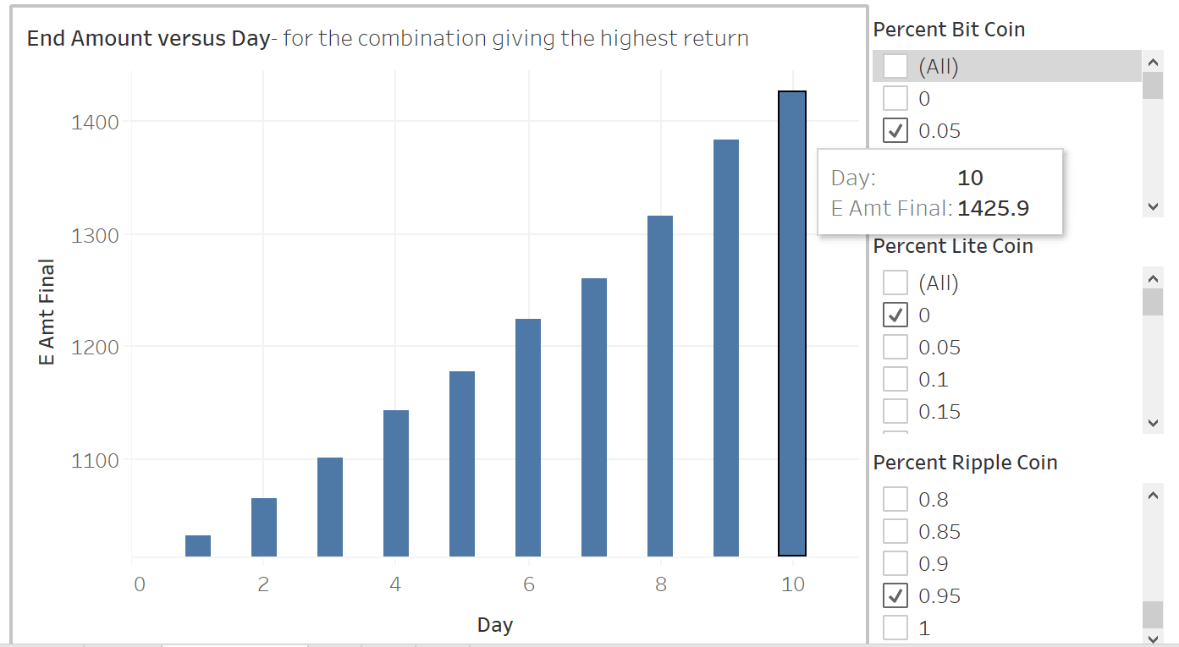

Slide 27
Scenario-2:
Model for 30 days

Slide 28
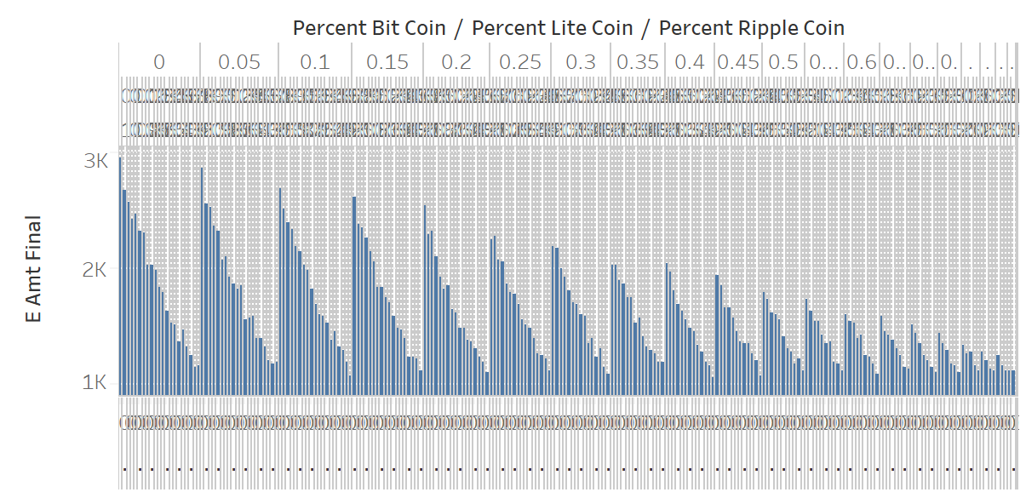

Slide 29
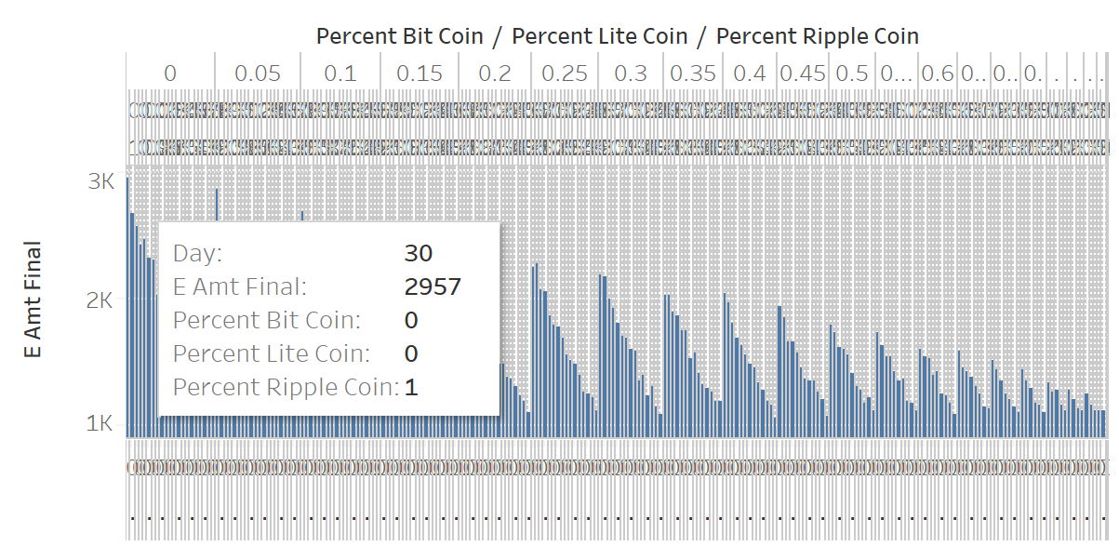

Slide 30
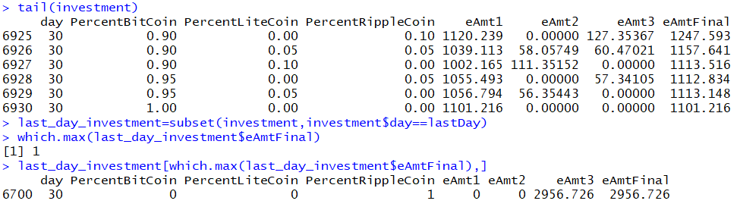

Slide 31
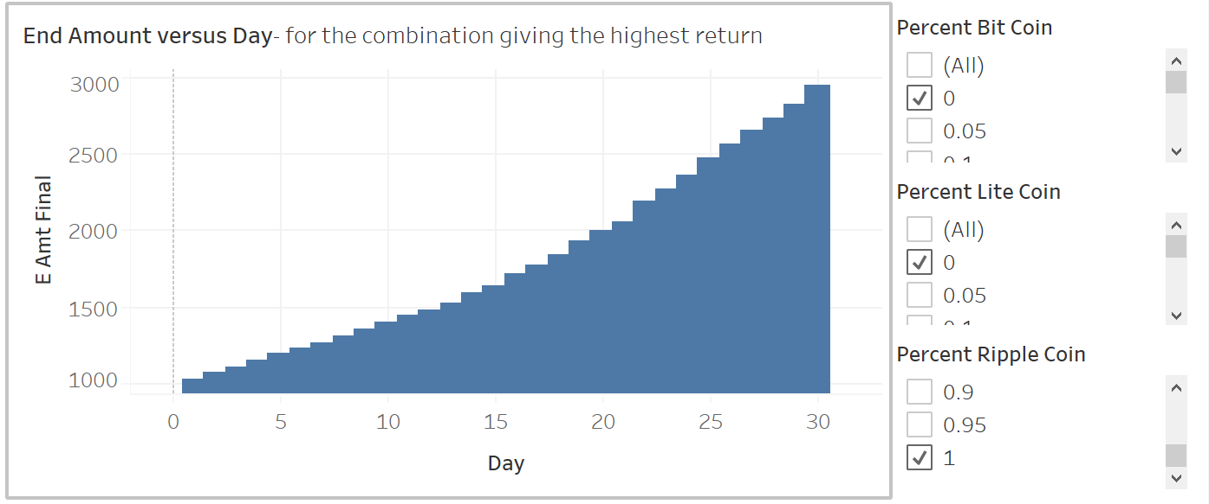

Slide 32
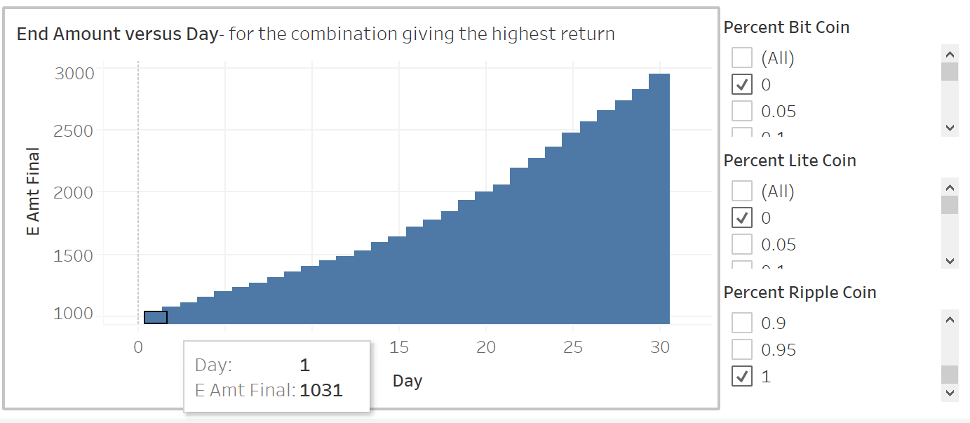

Slide 33
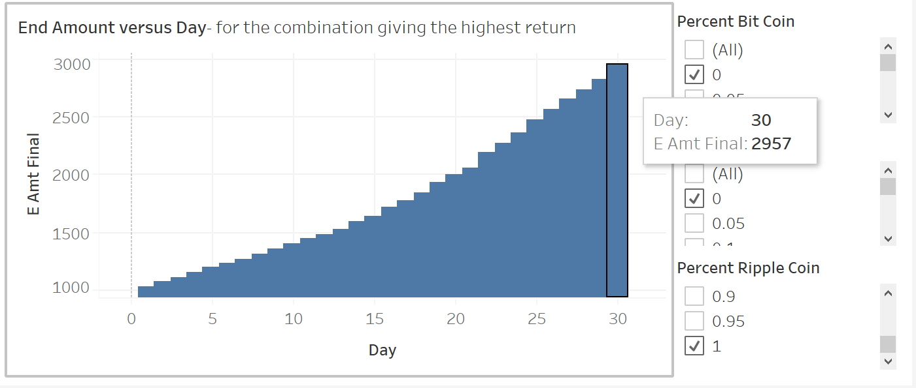

Slide 34
Conclusion
Therefore, to invest in crypto currencies we analyzed the past data of the crypto currencies and made future predictions about the smartest investment possible.

Slide 35
Future Scope
In future we will include other crypto currencies present in the market to get better insight of investment.
Right now the combinations of the investing amount are in multiple of 5. In future the combinations will be more granule

Slide 36
“With e-currency based on cryptographic proof, without the need to trust a third party middleman money can be secure and transactions effortless”
- Satoshi Nakamoto

